Slide 1
Productive GPU Software
This conference uses integrated audio. To interact with the host, you need a working microphone and speakers.
To speak, please click on the “Raise Hand” button in the Participants box. You can speak into your microphone after the host allows you to.
If you cannot hear the host, or if your voice is not being transmitted, please let us know using the Chat window.

Slide 2
Outline
Introduction to Jacket for MATLAB®
GFOR
Comparison with PCT™ alternative
Moving into the future
Case studies and code demos
MATLAB® and Parallel Computing Toolbox™ (PCT) are trademarks of MathWorks®

Slide 3
Easy GPU Acceleration of M code
n = 20e6; % 20 million random samples
X = grand(1,n,’gdouble’);
Y = grand(1,n,’gdouble’);
distance_to_origin = sqrt( X.*X + Y.*Y );
is_inside = (distance_to_origin <= 1);
pi = 4 * sum(is_inside) / n;

Slide 4
Matrix Types
gdouble
glogical
double precision
boolean
guint#
gint#
unsigned integers
gsingle
integers
single precision

Slide 5
Matrix Types: ND Support
vectors
matrices
volumes
… ND

Slide 6
Matrix Types: Easy Manipulation
A(:,:,2)
A(1,1)
A(1,:)
A(end,1)
A(end,:)

Slide 7
Easy GPU Acceleration of M code
n = 20e6; % 20 million random samples
X = grand(1,n);
Y = grand(1,n);
distance_to_origin = sqrt( X.*X + Y.*Y );
is_inside = (distance_to_origin <= 1);
pi = 4 * sum(is_inside) / n;

Slide 8
Easy GPU Acceleration of M code
No GPU-specific stuff involved (no kernels, no threads, no blocks, just regular M code)
“Very little recoding was needed to promote our Lattice Boltzmann Model code to run on the GPU.” –Dr. Kevin Tubbs, HPTi

Slide 9
GFOR – Parallel FOR-loop for GPUs
Like a normal FOR-loop, but faster
Regular FOR-loop (3 serial kernel launches)
for i = 1:3
C(:,:,i) = A(:,:,i) * B;
Parallel GPU FOR-loop (only 1 kernel launch)
gfor i = 1:3
C(:,:,i) = A(:,:,i) * B;

Slide 10
Example: Matrix Multiply
Regular FOR-loop (3 serial kernel launches)
for i = 1:3
C(:,:,i) = A(:,:,i) * B;
iteration i = 1
=
*
C(:,:,i)
A(:,:,i)
B

Slide 11
Example: Matrix Multiply
Regular FOR-loop (3 serial kernel launches)
for i = 1:3
C(:,:,i) = A(:,:,i) * B;
iteration i = 1
iteration i = 2
=
*
=
*
C(:,:,i)
A(:,:,i)
B
C(:,:,i)
A(:,:,i)
B

Slide 12
Example: Matrix Multiply
Regular FOR-loop (3 serial kernel launches)
for i = 1:3
C(:,:,i) = A(:,:,i) * B;
iteration i = 1
iteration i = 2
iteration i = 3
=
*
=
*
=
*
C(:,:,i)
A(:,:,i)
B
C(:,:,i)
A(:,:,i)
B
C(:,:,i)
A(:,:,i)
B

Slide 13
Example: Matrix Multiply
Parallel GPU FOR-loop (only 1 kernel launch)
gfor i = 1:3
C(:,:,i) = A(:,:,i) * B;
simultaneous iterations i = 1:3
=
*
=
*
=
*
C(:,:,1:3)
A(:,:,1:3)
B

Slide 14
Example: Matrix Multiply
Parallel GPU FOR-loop (only 1 kernel launch)
gfor i = 1:3
C(:,:,i) = A(:,:,i) * B;
simultaneous iterations i = 1:3
=
*
C(:,:,1)
A(:,:,1)
B

Slide 15
Example: Summing over Columns
Think of gfor as “syntactic sugar” to write vectorized code in an iterative style.
Three passes to sum all columns of B
for i = 1:3
A(i) = sum(B(:,i));
Both equivalent to “sum(B)”, but latter is faster (more explicitly written)
One pass to sum all columns of B
gfor i = 1:3
A(i) = sum(B(:,i));

Slide 16
Easy Multi GPU Scaling
y = gzeros( 5, 5, n );
for i = 1:n,
gselect(i); % choose GPU for this iteration
x = grand(5,5); % add work to GPU’s queue
y(:,:,i) = fft(x); % more work in queue
end
% all GPUs are now computing simultaneously, until done

Slide 17
Technology Stack
mldivide.mex
A full system making
optimizations for you
Including
“Core” brains
“JIT” speed
“Calls” heavy-lifting
convn.mex
Calls (library routines + JIT)
subsasgn.mex
find.mex
fft.mex
plus.mex
minus.mex
fft2.mex
JIT Engine(s)
times.mex
bsxfun.mex
bessel.mex
core
tan.mex
runtime
memory mgt
binary handling
GPU-multiplex
thread mgt
conv2.mex
power.mex
sum.mex
lu.mex

Slide 18
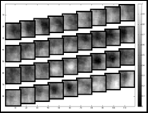
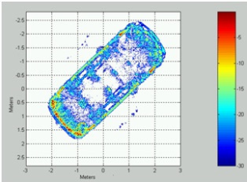
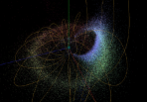
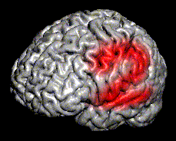
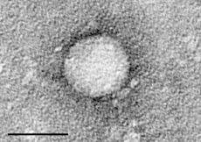
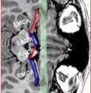
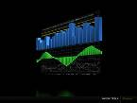
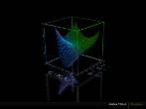
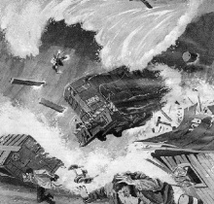
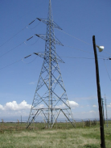
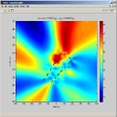
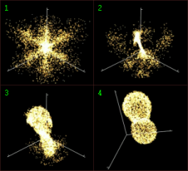
17X
20X
20X
45X
12X
Neuro-imaging
Georgia Tech
Bio-Research
CDC
Video Processing
Google
Radar Imaging
System Planning
Medical Devices
Spencer Tech
http://www.accelereyes.com/case_studies
5X
35X
17X
70X
35X
Weather Modeling
NCAR
Power Engineering
IIT India
Track Bad Guys
BAE Systems
Drug Delivery
Georgia Tech
Bioinformatics
Leibniz

Slide 19
Automated Optimizations
A = sin( x + y ).^2
300 cycles
one-way
GPU Memory
GPU Cores
CPU

Slide 20
Automated Optimizations
A = sin( x + y ).^2
300 cycles
one-way
GPU Memory
GPU Cores
Optimized via
runtime
Optimized via
async transfer and smart copy
CPU

Slide 21
Compare versus PCT
parallel computing toolbox™
A = sin( x + y ).^2
PCT
Load x, y (300 cycles)
+ (4 cycles)
Store Temp1 (300 cycles)
Load Temp1 (300 cycles)
Sin (~20 cycles)
Store Temp2 (300 cycles)
Load Temp2 (300 cycles)
.^ (~10 cycles)
Store A (300 cycles)
Jacket
Load x, y (300 cycles)
Sin( x+y ).^2 (34 cycles)
Store A (300 cycles)
MATLAB and PCT are products and trademarks of MathWorks.

Slide 22
Compare versus PCT
parallel computing toolbox™
A = sin( x + y ).^2
PCT
Load x, y (300 cycles)
+ (4 cycles)
Store Temp1 (300 cycles)
Load Temp1 (300 cycles)
Sin (~20 cycles)
Store Temp2 (300 cycles)
Load Temp2 (300 cycles)
.^ (~10 cycles)
Store A (300 cycles)
Jacket
Load x, y (300 cycles)
Sin( x+y ).^2 (34 cycles)
Store A (300 cycles)
634 cycles
1834 cycles
MATLAB® and PCT™ are products and trademarks of MathWorks.

Slide 23
Compare versus PCT
parallel computing toolbox™
A = sin( x + y ).^2
PCT
Load x, y (300 cycles)
+ (4 cycles)
Store Temp1 (300 cycles)
Load Temp1 (300 cycles)
Sin (~20 cycles)
Store Temp2 (300 cycles)
Load Temp2 (300 cycles)
.^ (~10 cycles)
Store A (300 cycles)
Jacket
Load x, y (300 cycles)
Sin( x+y ).^2 (34 cycles)
Store A (300 cycles)
634 cycles
Theoretically, a 3x increase. Actually, a 20x difference:
Legacy Java system
Better GPU code
1834 cycles

Slide 24
Jacket has 10X more functions…
gfor (loops)
gcompile (fine-grain)
gselect (multi-GPU)
reductions
sum, min, max, any, all, nnz, prod
vectors, columns, rows, etc
convolutions
2D, 3D, ND
interp and rescale
vectors, matrices
rescaling
FFTs
2D, 3D, ND
sorting
along any dimension
find
dense linear algebra
LU, QR, Cholesky, SVD, Eigenvalues, Inversion, det, Matrix Power, Solvers
image processing
filter, rotate, erode, dilate, bwmorph, resize, rgb2gray
hist, histeq
help
gprofview
and many more…

Slide 25
Easy To Maintain
Write your code once and let Jacket carry you through the coming hardware evolution.
Each new Jacket release improves the speed of your code, without any code modification.
Each new Jacket release leverages latest GPU hardware (e.g. Fermi, Kepler), without any code modification.

Slide 26
New in Jacket 2.1: Optimization
Unconstrained Optimization in 2.1
Gradient Descent and BFGS methods
Jacobian computation with GFOR
Batched-mode Optimization in 2.2
Search-based Optimization in 2.2
Constrained Optimization in 2.3

Slide 27
Sparse Roadmap
Current functions supported:
Matrix multiply
Triangular matrix solve
Iterative solvers with no pre-conditioning.
Examples: CG, BICG, BICGSTAB, BICGSTABL, GMRES, LSQR
Under development:
Iterative solvers with pre-conditioning and improved performance
Examples: CG, BICG, BICGSTAB, GMRES

Slide 28
Move to C/C++, Fortran, or Python
ArrayFire GPU library
Free version for most users (single GPU usage)
Pro version (multi-GPU usage)
Available for CUDA or OpenCL devices
The World’s Largest, Fastest GPU Library

Slide 29
ArrayFire Example (C++)
#include <stdio.h>
#include <arrayfire.h>
using namespace af;
int main() {
// 20 million random samples
int n = 20e6;
array x = randu(n,1), y = randu(n,1);
// how many fell inside unit circle?
float pi = 4 * sum<float>(sqrt(mul(x,x)+mul(y,y))<1) / n;
printf("pi = %g\n", pi);
return 0;
}

Slide 30
Case Studies
See more examples: http://www.accelereyes.com/examples/case_studies
http://blog.accelereyes.com/blog/

Slide 31
Case Study: Australian Brokerage
Description: Nonlinear regressive model fitting
Speedup: 115x
Solution: Jacket, Jacket DLA, ArrayFire Pro, Consulting

Slide 32
Case Study: Australian Brokerage
Description: Modified conjugate gradient for sparse matrices
Speedup: 10-30x (Depends on data size. Larger data gives bigger speedups.)
Solution: Jacket, Jacket SLA, ArrayFire Pro, Consulting

Slide 33
Case Study: Koch Industries
Description: Option pricing based on Monte-Carlo simulation
Speedup: 60 - 70x
Solution: Jacket

Slide 34
Case Study: Bank of America
Description: Visualization of server utilization and workloads, required to run in MATLAB®
Focus only on visualization, not computation
Result: Beautiful OpenGL 3D renderings
Solution: Jacket with the Graphics Library

Slide 35
Automotive Trader Example
Description: Algorithmic trading
Speedup: 37x on 3 GPUs (14x on 1 GPU)
Solution: Jacket, Jacket MGL for 3 GPUs
Learn more: http://www.automatedtrader.net/articles/software-review/107768/mashup

Slide 36
Demos

Slide 37
Discussion
Faster MATLAB® through GPU computing

